Slide 1
Competitive Cyber Security Organization
General – Security Information and Event Management
By attending today’s meeting you acknowledge that you may be photographed or recorded for club use

Slide 2

Announcements
Paintball Signup – Oct 4th
Hivestorm – 1st Meeting Next Wednesday Oct 2nd 6pm @ Cybertorium
Board & Video Game Social – Next Wednesday Oct 2nd 6pm
Next GBM – Lockpicking Oct 9th 6pm @ Cybertorium
Paintball

Slide 3
Learning Objectives:
SIEM Basics
Identify Suspicious Activity
Hands-On Experience

Slide 4
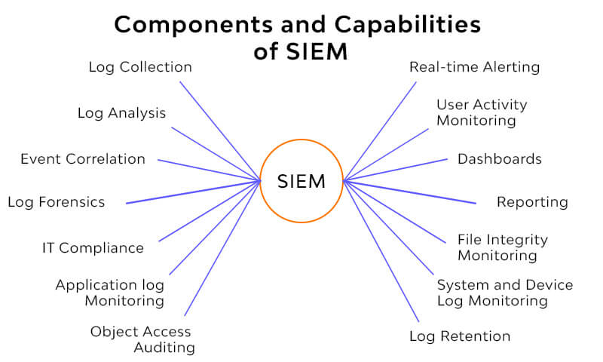
What is a SIEM?
tool to gather data into a central location for easy analysis
“Data” includes logs, events from EDR and IDS systems, and system activities

Slide 5
Why do we use it?
See data from multiple logs on multiple devices
A bird’s eye view of the network for easy DFIR
Alerting based on events for quick reactions

Slide 6
Intro to ELK Stack
Elasticsearch – The log analytics and search engine that is used to filter through and analyze logs
Kibana – The dashboard software that allows us to visualize data in a clean and easily understandable manner
Additional tools – Logstash, Beats, etc.

Slide 7
Walkthrough
Go to https://kibana-demo.psuccso.org/
Cred:
Username: ccsomember
Password: K3tchupPr3@mbl3B0rr0w

Slide 8
Airport Data Questions:
Who is the most common Carrier?
How many flights do they have?
What is the median ticket price of a canceled flight?
What about the average? (visualize)
Where were most of the planes going?
What day had the most air travel?
Taylor Swift's private jets ran out of fuel and she needs to get from her show in Dubai to a Chiefs game in Kansas City in the next week. If the flight plan for next week is the same as this week what flight number is she taking?
If she then has to travel from Barcelona to Warsaw, what flights can she take? Assume the flight leaves at the time of the timestamp.

Slide 9
One Possible Answer
Flight ZJVS0HT from Barcelona to London
Flight 5MLVU56 from London to Seattle
Flight O4GG2VJ from Seattle to Warsaw (Final timestamp Sep 20, 2024 @ 17:15:00.000)

Slide 10
Challenge
Applying it to Cyber
Open data
Step through the data to get a feel for it

Slide 11
Questions:
Q1: What webmail service is access?
Q2: What IP address attempts to exploit fp30reg.dll?
Q3: What was the attacker attempting to do?
Q4: What CVE does this attack relate to?
Q5: What is the other dll that was requested?
Q6: What suspicous activity did 222.134.69.86 do?
Q7: Were any of these attacks successful?

